Slide 1
uArcSim Implementation by AI
WYLin, 2026.05

Slide 2
Agenda
Motivation
uArcSim
Design Flow
Model Level
Profile and GUI
Performance Tuning
AI Harness Engineering
Next Step

Slide 3
Motivation
Motivation : MDLA7 L1Mesh AA Model
Solution
MDLA6 Traffic Log and Log Player
AA Model (Cannot get is optimization patterns before 6/E)
Brand-New Test Framework : uArchSim

Slide 4
uArchSim
An IP accelerator modeling and verification platform by AI
AI Tool : Claude and Codex
Input documents (No violation of PIM policies)
Block Diagram (Hand sketch)
Throughout Table (md)
Human Resource
Top Down ： 2 Week (WY)
Bottom Up : 4 Weeks (PJ)

Slide 5
uArcSim Design Flow
Hand Sketch ⇨ Picture ⇨ Drawio (by AI)
Download
ETHZ_v5/v6.tflit
Log
Host
TensorFlow
Python Golden
Waveform
Block Map
Throughput Table
TensorFlow
Slicer
Batch
Regression
1. Gate Count
2. Synthesizable Checking
Compiler
Profile
Yosys
Synthesis
Fast Mode
SystemC
CX Mode
SystemC
Verilog
(hw/dpi)
Verliator
Simulator
Document
Correlation

Slide 6
MDLA7 System Block Diagram
Hand Sketch ⇨ Picture ⇨ Drawio (by AI)
Host
1T
Descriptor
Command Engine
W 1T
W 1T
W 1T
W 1T
4096b/cyc
CONV Engine
Requant
EWE Engine
POOL Engine
TNPS Engine
32x16B R ACT
32x16B R WGT
8R/8W (16Bytes)
16R/8W
16R/8W
8R/8W
L1Mesh
L1_Manager
3 MB
16R/16W
16R/16W
UDMA
Legend
Payload lanes
AXI_R
AXI_W
1T config/control
4 GB DRAM

Slide 7
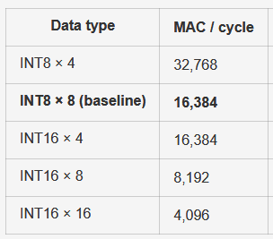
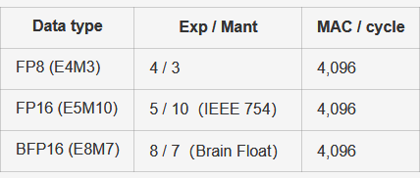
Module Functions and Throughput
System Parameters
1.9 GHz core | 62.3 TOPS INT8x8 baseline
3 MB L1Mesh SRAM | LPDDR5X-10667, dual x32
64B descriptors via DRAM ring + MMIO doorbell
Module
Function
Throughput / Modeling Point
CONV
Conv / FC / DWConv MAC
INT8x8: 16,384 MAC/cyc; 62.3 TOPS @1.9GHz
Requant
INT32/FP post-processing, clamp, scale/shift
16 CONV-chain lanes; Payload W 128 B/cyc
EWE
Add/Mul/Sub/activation/math/softmax pieces
64 elem/cyc; R 256 B/cyc, W 128 B/cyc
POOL
Max/Avg/Global pooling
R 256 B/cyc, W 128 B/cyc
TNPS
Transpose/Slice/Space-depth/Layout materialize
128 B/cyc read + 128 B/cyc write
UDMA
DRAM↔L1 copy, prefetch, store, ACT codec
LPDDR5 model peak ≈85.3 GB/s external
L1Mesh
3 MB banked scratchpad / routing fabric
16 banks x 16B per SRAM cycle backend
MDLA7 SystemC Performance Model | internal technical briefing
5

Slide 8
Layer to Microblock architecture and compiler
Layer graph
↓
Compiler / graph compiler
Layer fuse / graph-level fuse
↓
Compiler / tiler
Tile split
↓
Compiler + Command Engine ABI (Application Binary Interface)
Tile-level fuse / L1 SRAM handoff
↓
Command Engine
Microblock pipeline / wavefront

Slide 9
Microblock Pipeline Path for regression
Scan ETHZ_v6 Patterns to generate Microblock Path Slice Patterns by AI for function coverage and easy debugging
Name | Scope or shape | ETHZ_v6 Slicing Patterns
Producer compute | CONV/DW/FC/EWE/POOL/TNPS -> L1 tile | 44
Consumer tail | producer -> EWE/POOL/TNPS/store | 52
Layout bridge | sslice/concat/d2space/transpose -> compute | 286
Fanout/live-range | one producer -> multiple consumers | 34
UDMA as engine | udma_r/udma_w preload/store participates in pipeline | 9
Streaming preload | udma_r head/tail -> compute overlap | 134

Slide 10
Modeling Level and Version
version | Meaning | source path | Batch | Speed
fast | analytical / functional SystemC model | systemc/ | run_systemc.py
cx | SystemC synth timing / microblock model | systemc/ | run_systemc.py --L1=cx --engine=cx
verilog | RTL Verilog path，control + datapath | rtl/verilog/ | run_verilog.py –-option dpi run_verilog.py

Slide 11
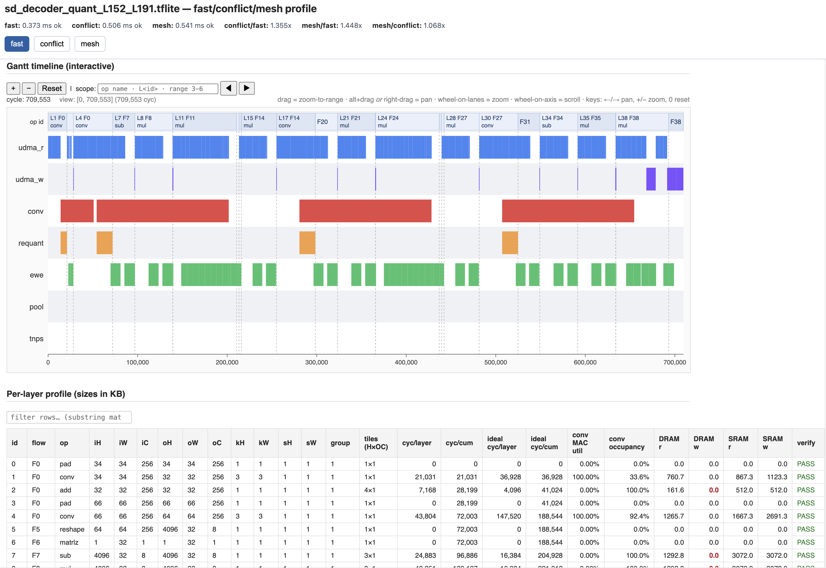
Profile
7

Slide 12
Performance Tuning
Tunning Approach
Baseline profiling
Tiling and micro-blocks
Layer Fuse
Engine Overlap Scheduling
Engine Bubbles
Prompt Examples
/goal E2E function 100%, turning performance 不能掉, 算法 要是 general rule
Check ETHZ_V6 不是最後一層有大量的 DRAM Write 列出來 然後最佳化
Check ETHZ_V6 Layer 可以Fuse 成 Flow 沒 Fuse起來的 列出來 然後最佳化
Check ETHZ_V6 Flow 沒有切成 Microblock 列出來 然後最佳化
Check ETHZ_V6 Flow 間 Engine 可以平行 沒有平行 列出來 然後最佳化
Check ETHZ_V6 Flow 間 可以 Prefecth 沒有 Prefecth 列出來 然後最佳化
7

Slide 13
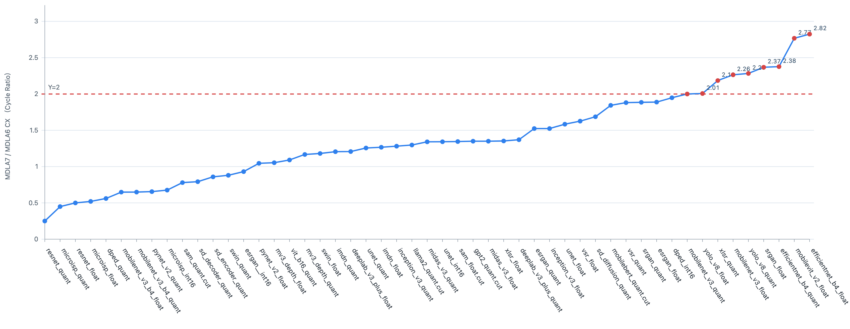
MDLA7 uArchSim Regression Table
Clock
Engine : 1.9GMHz
SRAM : 1.3G
BW
DRAM : LPDDR5
Computer Power
MDLA6: 4 Cores
MDLA7: 1 Cores ~~ MDLA6 2 Cores

Slide 14
Modeling for L1Mesh
Methodology
Top down (0.5 hours)
Bottom up (2 Weeks)
Hierarchy
SRAM Macro (1 Port R/W, 768x16Bytes, 12K)
Quad SRAM Macro (4 Port R/W, 48K)
Mesh4x4 (16*Quad SRAM Macro, 768K)
L1Mesh (4*Mesh4x4,3M)
Edge Injection match R/W Requests (32R+32W+16R+16W)
2xMesh4x4 mapping to same 16*Quad SRAM Macro
7

Slide 15
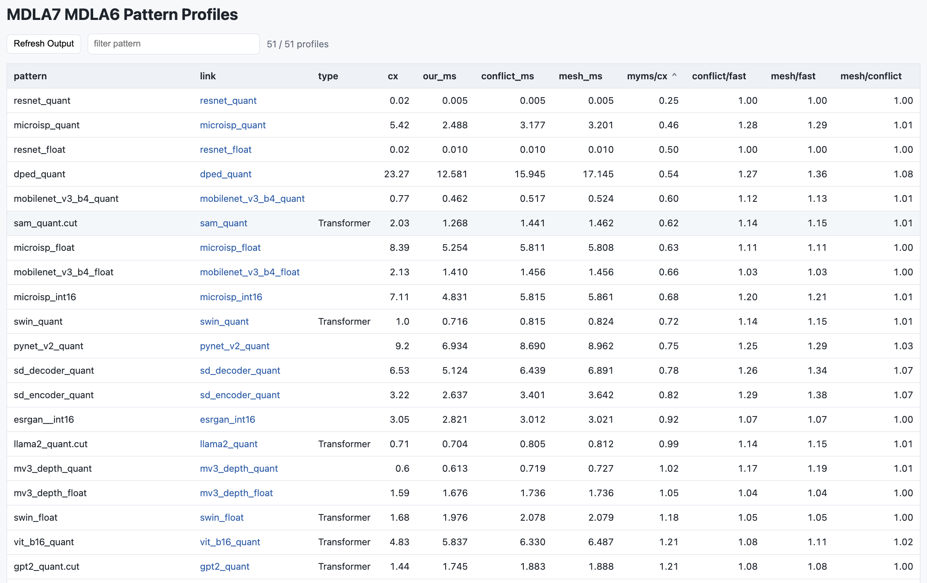
Regression Table & L1Mesh Evaluation
7

Slide 16
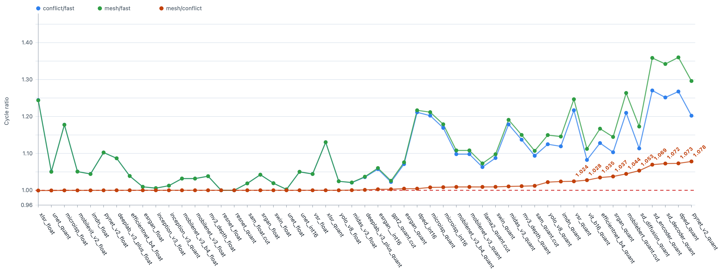
L1Mesh Evaluation (v0.1 version)
L1Mesh Simulation Mode : Fast/SRAM Port Conflict/Mesh

Slide 17
Verilog Simulator Comparison
評比項目 | Verilator | Icarus Verilog | 商用模擬器 (VCS/Questa)
效能 (Speed) | 極高 (最快) | 低 | 極高
精確度 (Accuracy) | 週期精確 | 全時序精確 | 全時序精確
License 費用 | $0 (開源) | $0 (開源) | 極高 (按 Core 計費)
主要用途 | SoC/CPU 功能驗證 | 單元測試/教學 | 全面簽核 (Sign-off)

Slide 18
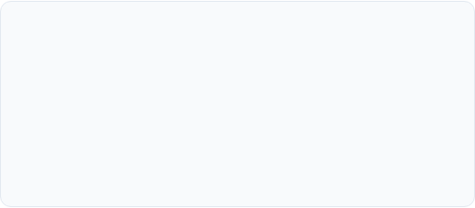
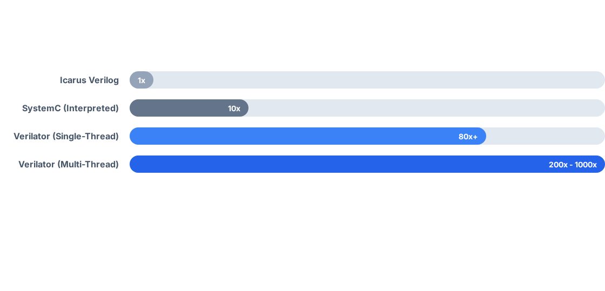
Verilog Run with Verilator
Verilator (Compiled)
將 RTL 直接編譯為優化的 C++/SystemC。它主要採用週期精確 (Cycle-accurate) 的模擬方式，犧牲了時序細節以換取極致的運算速度。
IEEE 1800-2017: 高度支援最新的 SystemVerilog 標準。
傳統模擬 (Event-driven)
如 Icarus Verilog。逐個事件處理，支援精確的 #delay 與四態邏輯 (X/Z)，但處理大型 SoC 時速度極慢，成為驗證瓶頸。
Assertions (SVA): 支援並行與即時斷言檢查。
VPI/DPI: 完善的 C/SystemVerilog 外掛介面支援。
限制： 預設為二態邏輯 (0/1)，有限度支持 X/Z 態。

Slide 19
Harness Engineering 用AI 幾週的心得
目前 Codex > Claude Code > Gemini
DLA7 Project ： 10美元 玩 4小時 100美元 3天 200美元5天
AI 是一位很厲害的同仁 看完目前全世界的書 及 Paper
AI 很博學 會教你不會的知識 生成 讀書報告(未來新人訓練)
我是剛新進公司的員工 想從基礎學習
請幫我看文件及Code 有系統寫下150頁 讀書筆記
AI 不會幫你設計架構 但它會逼你把每個設計 decision 講清楚
你也可以問一般業界怎麼做 把問答題變成選擇題
AI 會偷懶 要先想好很嚴謹的驗收條件
找 ETHZ Pattern E2E Evaluation
用別的 TOOL 來驗證它 (eg. Verilog Simulator + Correlation)
Top-down Design 比 Bottom-up 好溝通
Context Window 有限 Compact之後就會忘了前面 重要事情還是一直要提醒
Tod-down Design 真的不用看 Code
關機要寫 Handoff to Handoff.md 隔天開工先讀它
對它客氣一點 不要爆粗口 這樣容易它選不好的回應來回答你問題

Slide 20
Next Step
MDLA7 1-Core System
L1Mesh Design
L1Mesh CX Model Approach form Verilog
Fine Tune Compile for Fast/CX Model
CX/Verilog Correlation
Find gap of FE/IA/CX speed with simulator designed byAI
MDLA7 2-Cores System
MVPU 2.5 System

Slide 21
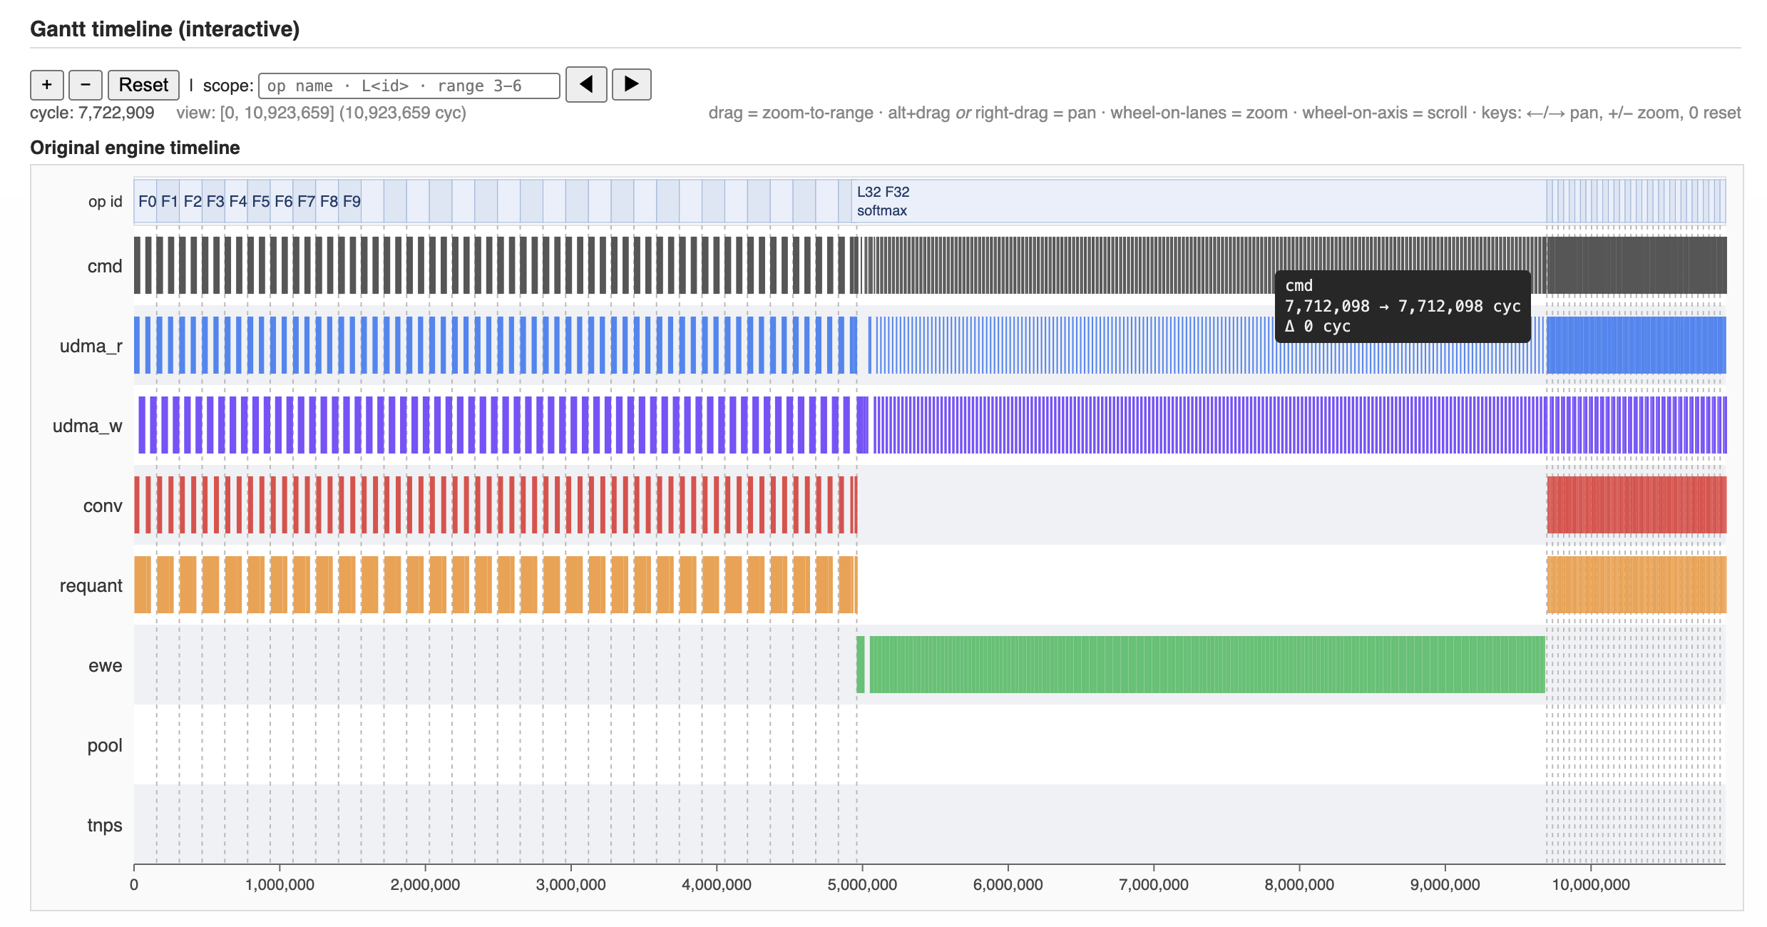
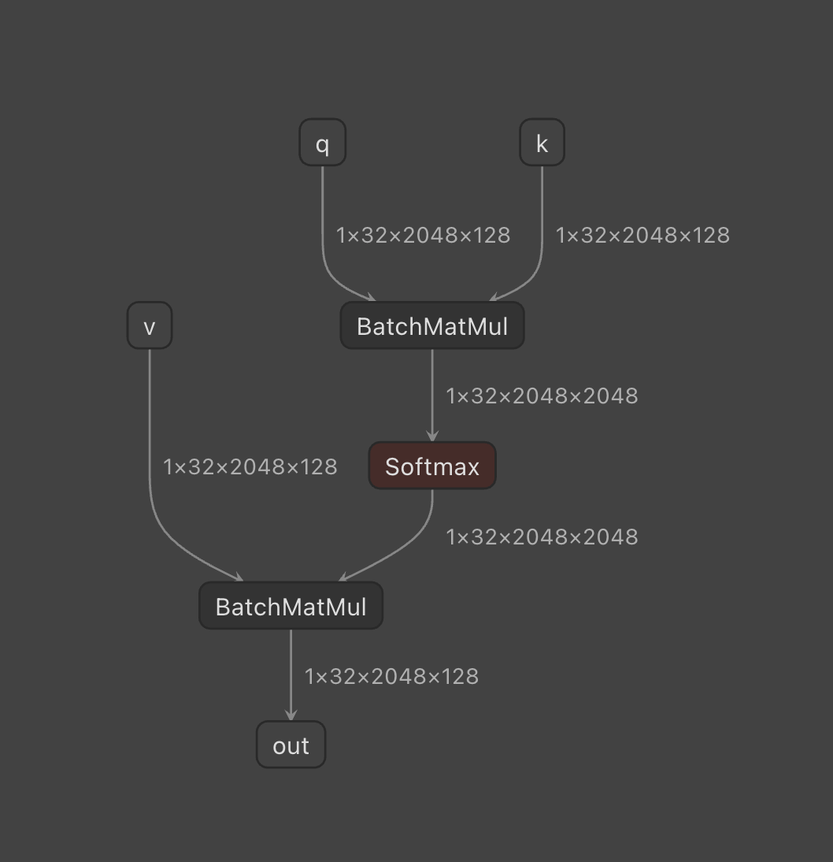
BMM-Softmax-BMM 第一版
MDLA7 profile — bmm_softmax_bmm_2.5ms_1g_int8.tflite (fast)
Model: model/BMM/bmm_softmax_bmm_2.5ms_1g_int8.tflite
Compiled layers: 65 (PASS 63 / FAIL 2)
Graph coverage: complete — 0/65 compile rows skipped
Verification: per compiled-layer DRAM reference compare, including the final compiled layer; no separate original-TFLite final-output checker
Sim time: 5.749 ms @ 1.9 GHz (10,923,659 cycles)
Util: avg 24.4% / peak 55.4% (udma_w)
DRAM r/w: 142.58 / 276.82 MB
SRAM r/w: 672.29 / 579.44 MB

Slide 22
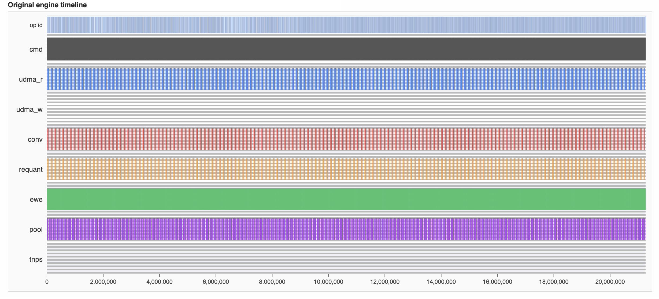
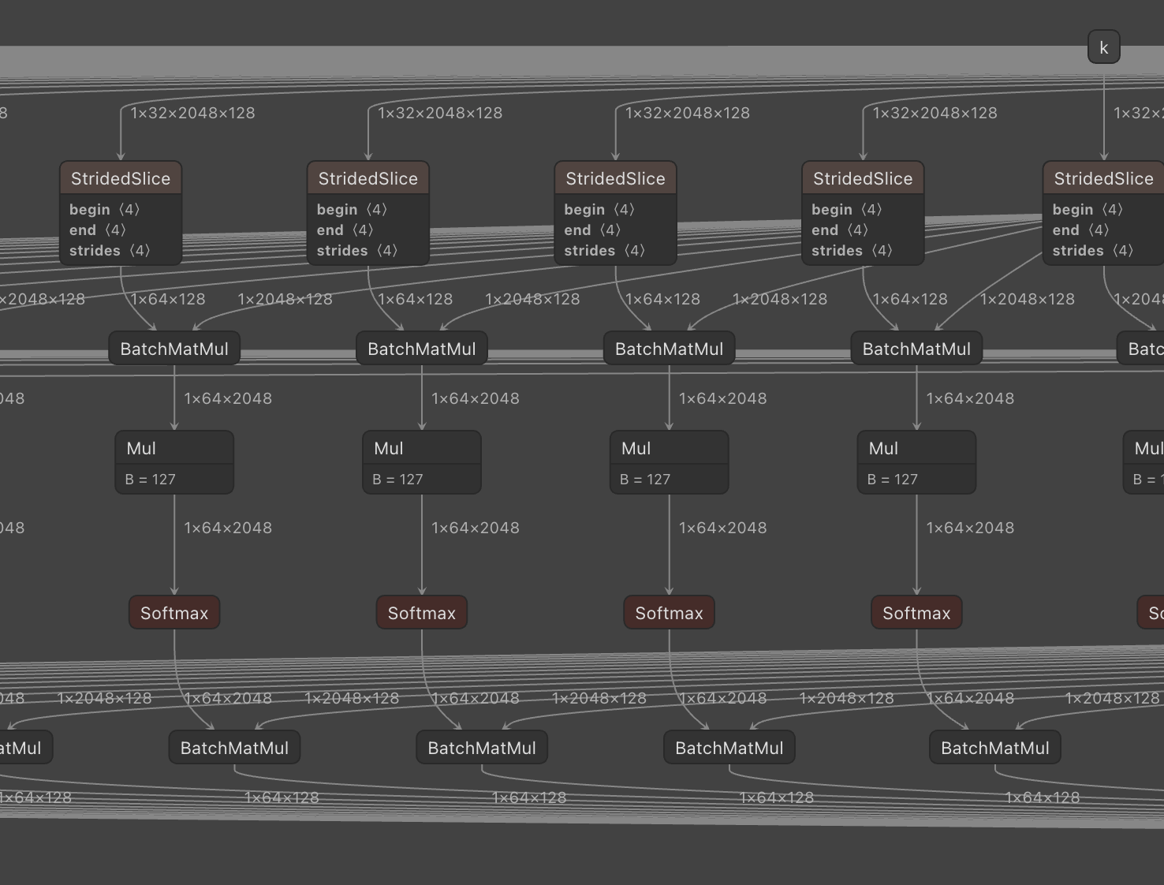
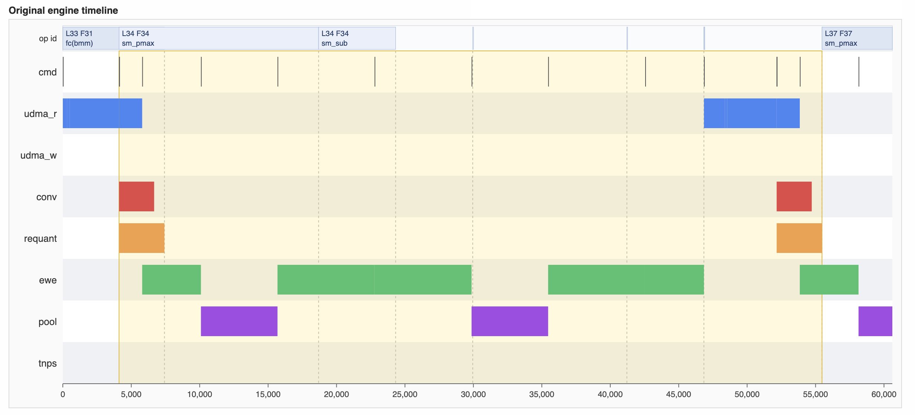
BMM-Softmax-BMM 第二版
MDLA7 profile — bmm_softmax_bmm_tiled_2.5ms_int8.tflite (fast)
Model: model/BMM/bmm_softmax_bmm_tiled_2.5ms_int8.tflite
Compiled layers: 1358 (PASS 1358 / FAIL 0)
Graph coverage: INCOMPLETE — 1/1359 compile rows skipped; simulator PASS covers compiled layers only
Verification: per compiled-layer DRAM reference compare, including the final compiled layer; no separate original-TFLite final-output checker
Sim time: 11.184 ms @ 1.9 GHz (21,249,675 cycles)
Util: avg 14.0% / peak 62.1% (ewe)
DRAM r/w: 161.30 / 0.00 MB
SRAM r/w: 185.57 / 301.56 MB

